Slide 1
The battle of the Neighbourhoods - Chennai
By,
Lingesh R

Slide 2
Introduction
Chennai, Tamil Nadu is home to a large number of business, from micro to big companies.
In this project we will determine the optimal location to open a restaurant in the Chennai district.
We will be targeted at stakeholders interested in opening a restaurant in Chennai.
We will utilize data science and machine learning techniques in order to do this.

Slide 3
Data Description
3 data sets
1. Data Set containing names of municipality scrapped from Wikipedia
2. Data set containing geo coordinates, creating using Geocoder package
Data from FourSquare API showing venues

Slide 4
Methodology
Utilized one hot encoding to replace categorical variables w/ 1’s and 0’s
Analyzed frequency of mean occurrence of each category
Clustered Data using K-means clustering
K-Means simple and efficient

Slide 5
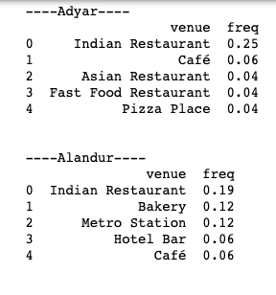
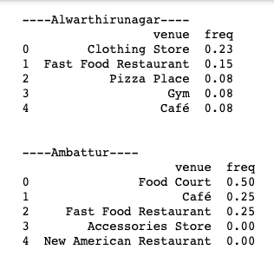
Example frequency of four Venue

Slide 6
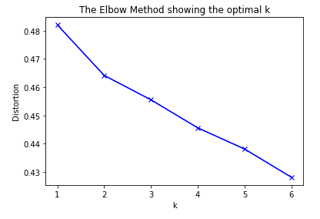
K-Means Clustering: choosing the right K
Utilized ‘elbow’ method
Optimal k: 3

Slide 7
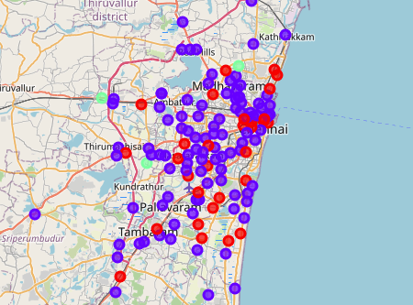
K-Means Visualizing the clusters

Slide 8
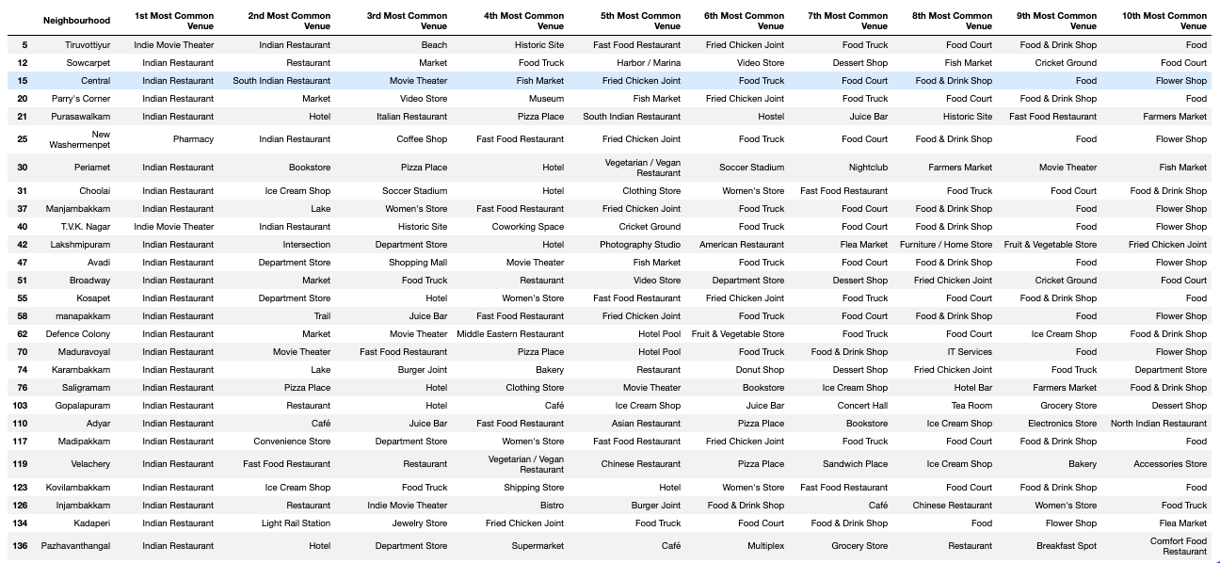
K-Means Cluster 1

Slide 9
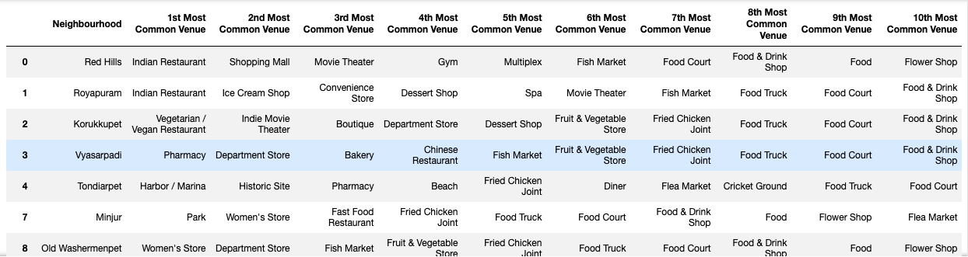
K-Means Cluster 2

Slide 10
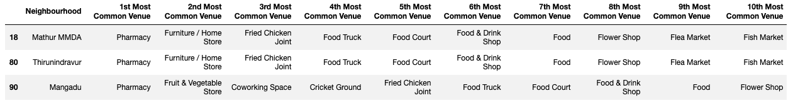
K-Means Cluster 3

Slide 11
Discussion and Conclusion
Best type of restaurant: Indian
Optimal Location: Any District in cluster 1
Final Decision left to stakeholders
Analyses are not perfect
Should be used with other tools/techniques of decision making

